Slide 1
Temperature-
Controlled Fan
EE 2361 Final Project
By: Yuan Jiang
Soorya Sundravel
Hongyu Wang
Thomas Skrzek

Slide 2
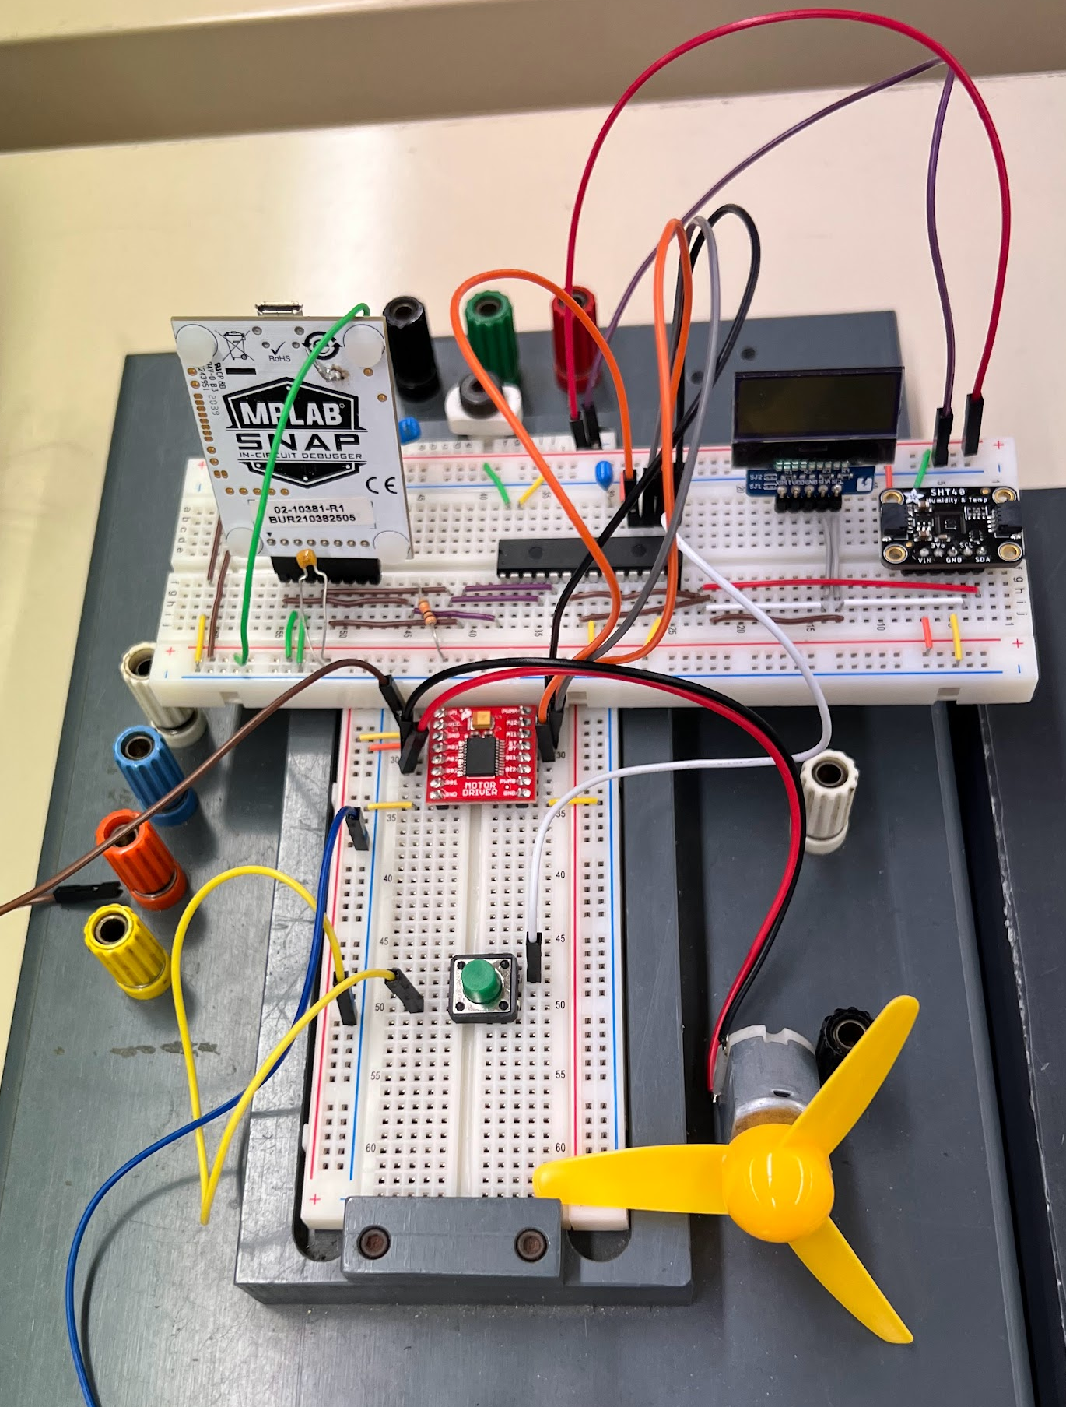
Introduction
The purpose of this project is to build a fan that turns on at a certain temperature automatically. The speed of the fan can be controlled manually by the press of a button. The fan turns off when the temperature drops below the threshold. An LCD display is also used to show the temperature data.

Slide 3
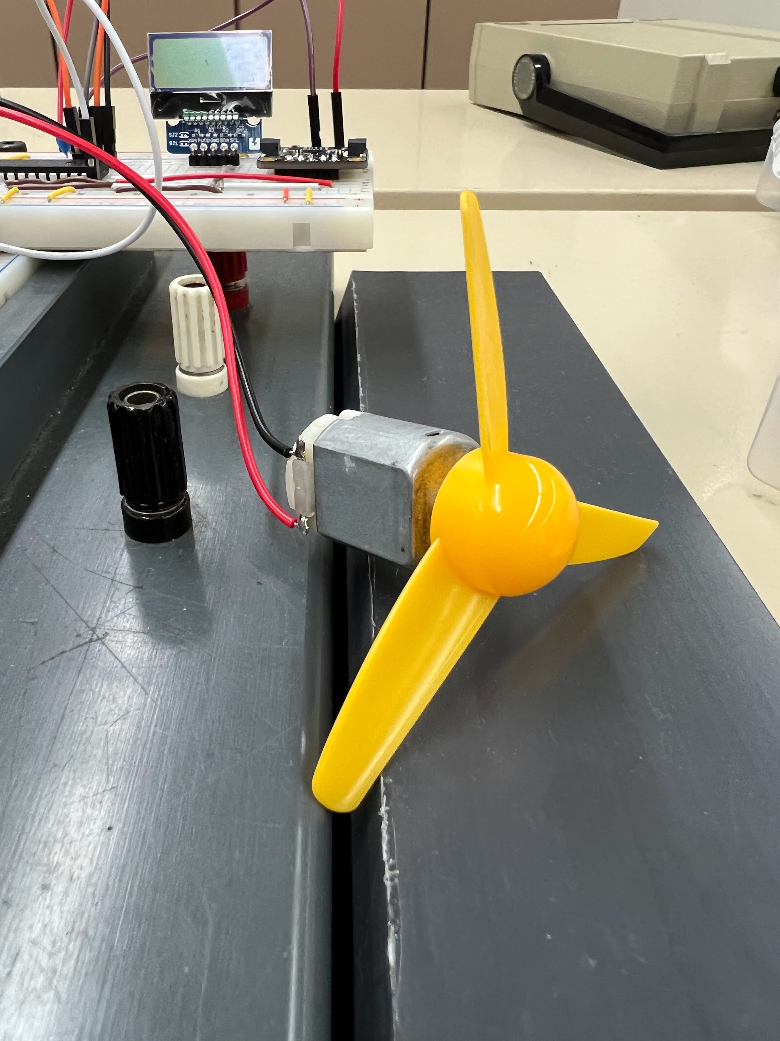
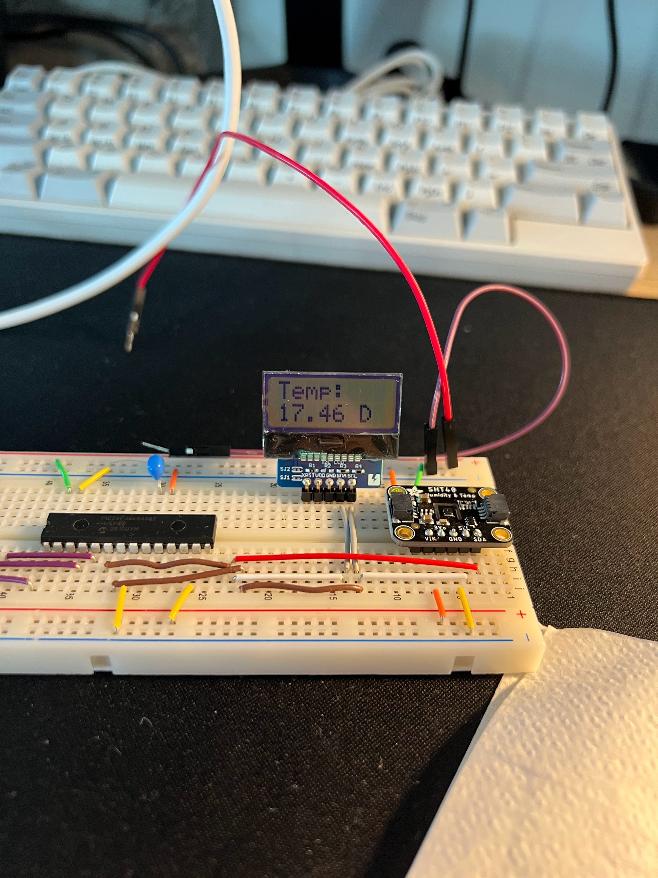
Applications of the Fan
The fan can be implemented in any scenarios that require activation at a certain temperature. For example, it can be used to circulate air in a hot summer room, or cool down an electrical device when the temperature gets high.

Slide 4
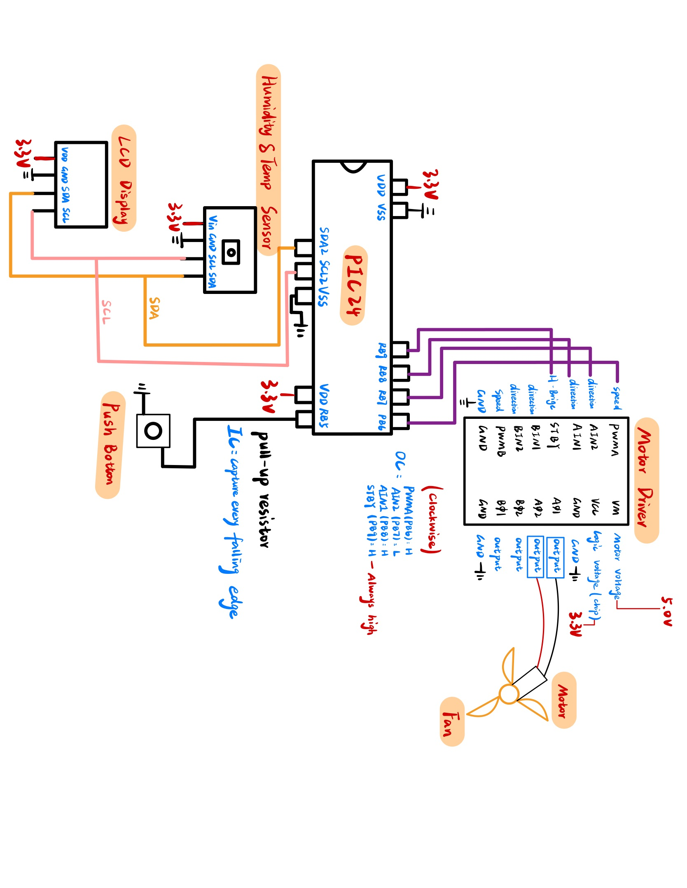
Hardware Block Diagram
Microcontroller (PIC24FJ64GA002)
SCLx, SDAx pins for I2C (Sensor and LCD)
Output Compare (Motor Driver)
Input Capture (Push Button)
Motor Driver (TB6612FNG)
PWMA -> RB6
AIN2 -> RB7
AIN1 -> RB8
STBY -> RB9
Humidity & Temp Sensor (SHT40)
SCL -> SCL2
SDA -> SDA2
LCD Display (AQM0802A-RN-GBW)
SCL -> SCL2
SDA -> SDA2
Push Button
Input Capture -> RP5 (pull-up resistor)
5V DC Source (INSTEK GW3030D)
5V DC -> VM
Motor + Fan
A01
A02

Slide 5
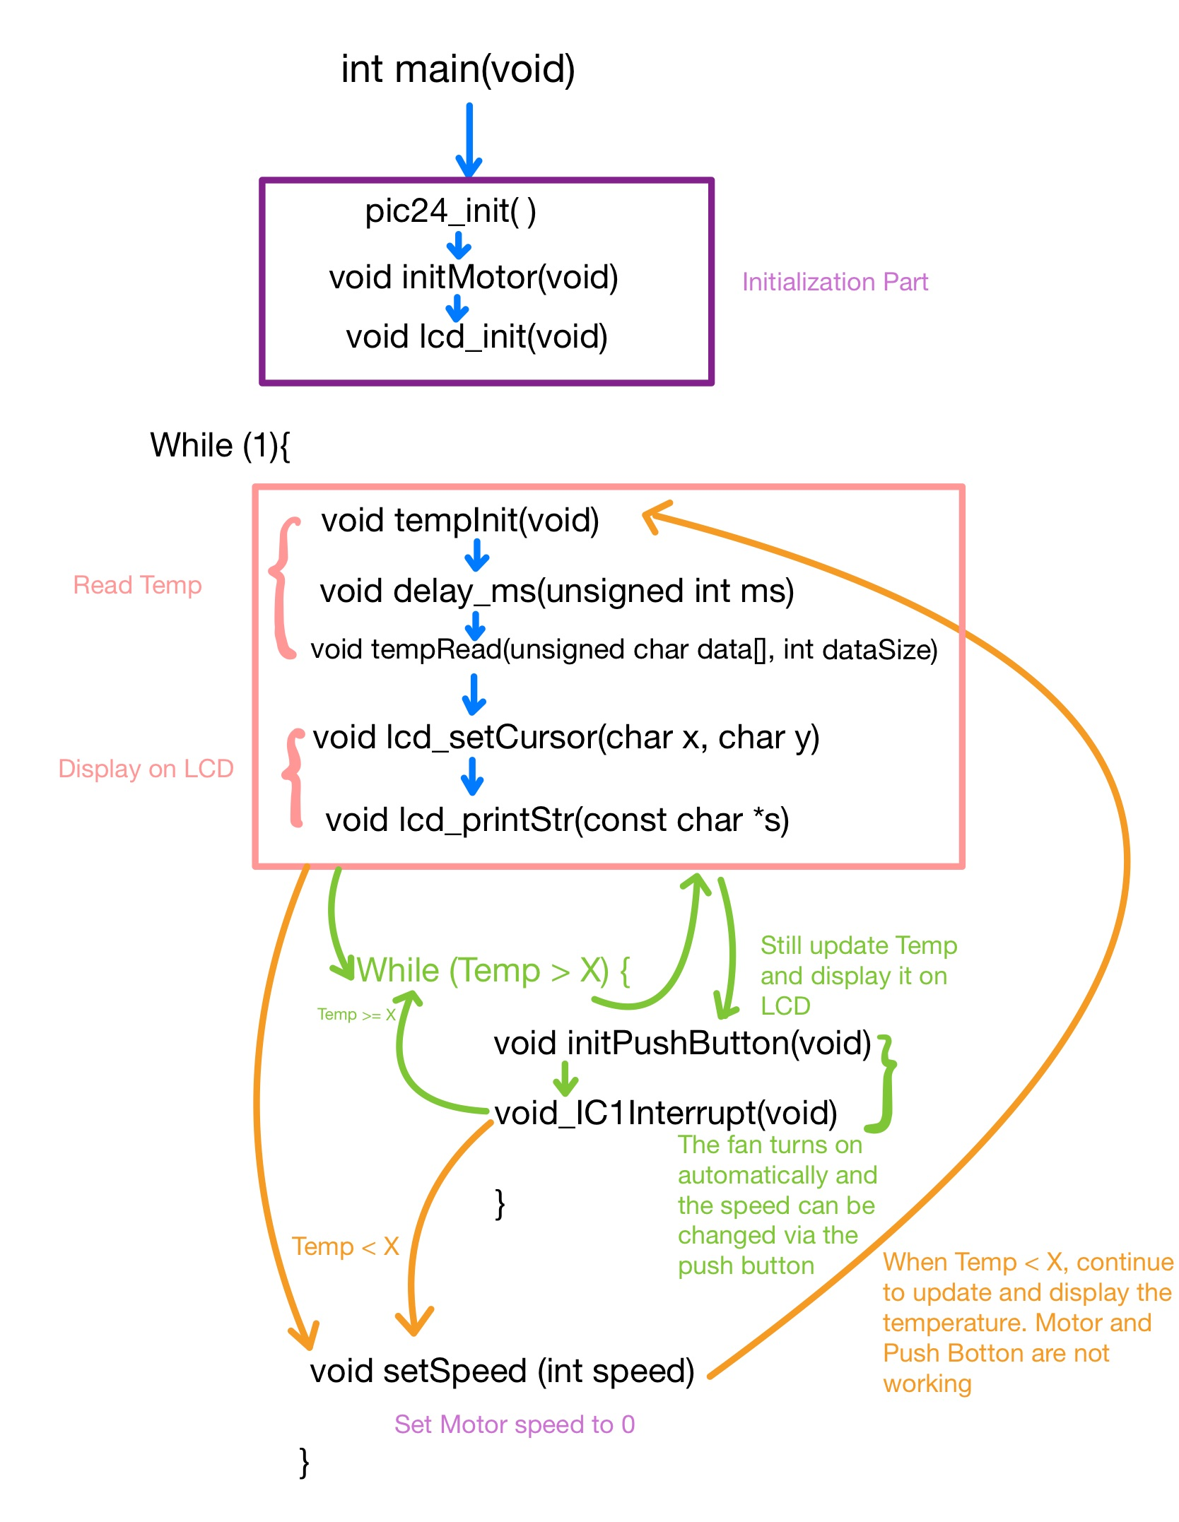
Libraries + Software Block Diagram
MotorLib.c
void setSpeed(int speed);
void initMotor(void);
void initPushButton(void);
void_IC1Interrupt(void);
TempLib.c
void tempInit(void);
void tempRead(unsigned char data[], int dataSize);
final_LCDLib.c
void delay_ms(unsigned int ms);
void lcd_cmd(char Package);
void lcd_init(void);
void lcd_setCursor(char x, char y);
void lcd_printStr(const char *s);

Slide 6
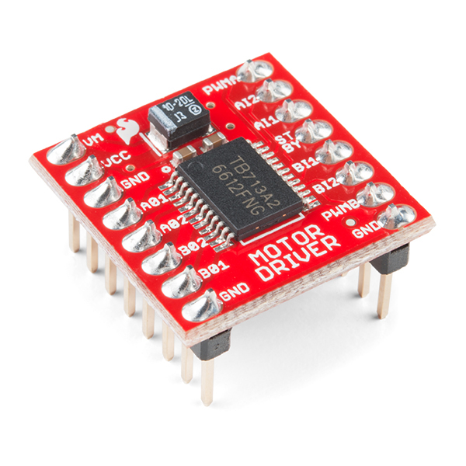
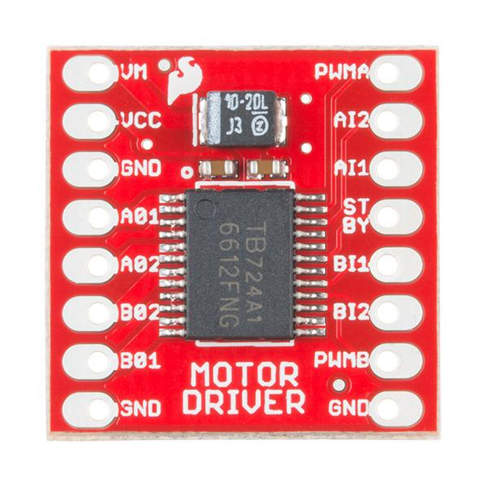
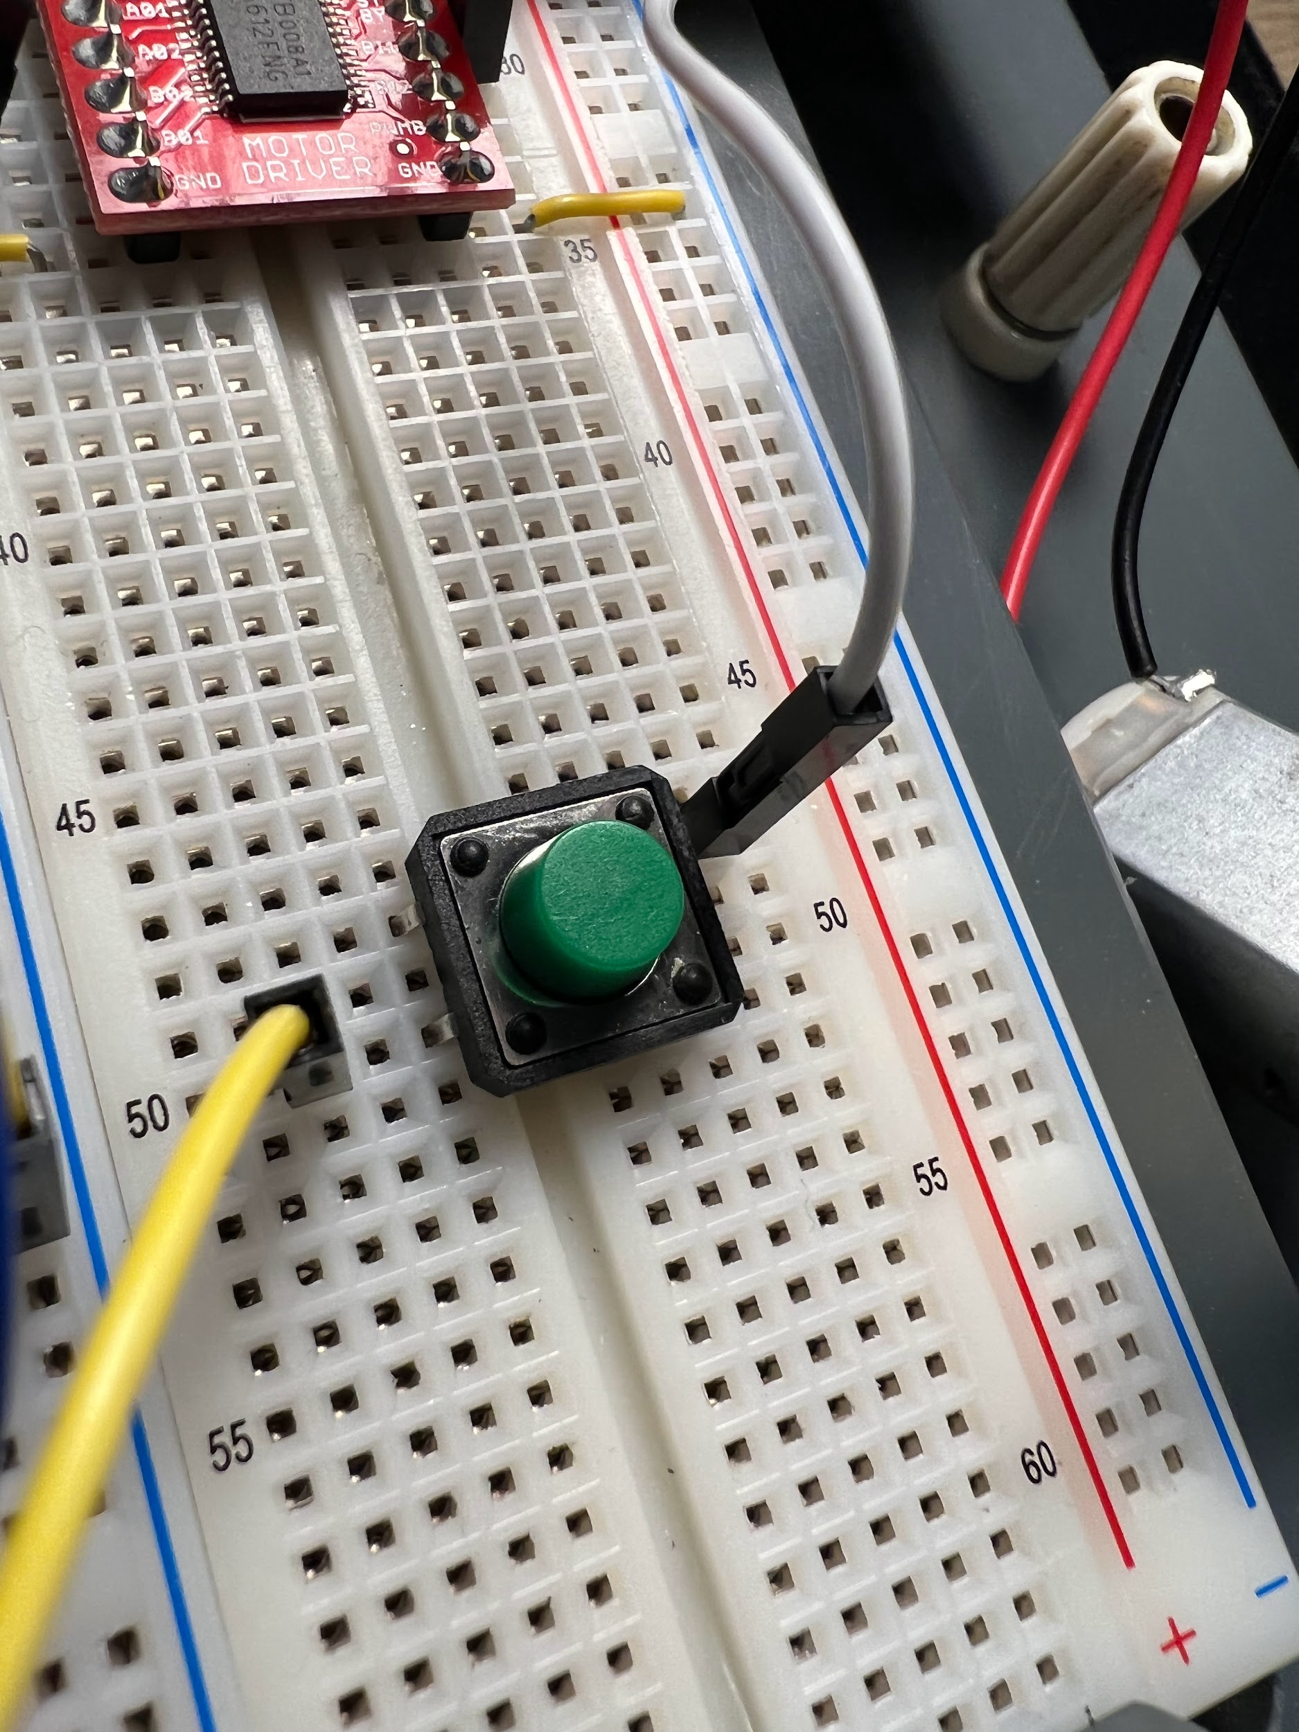
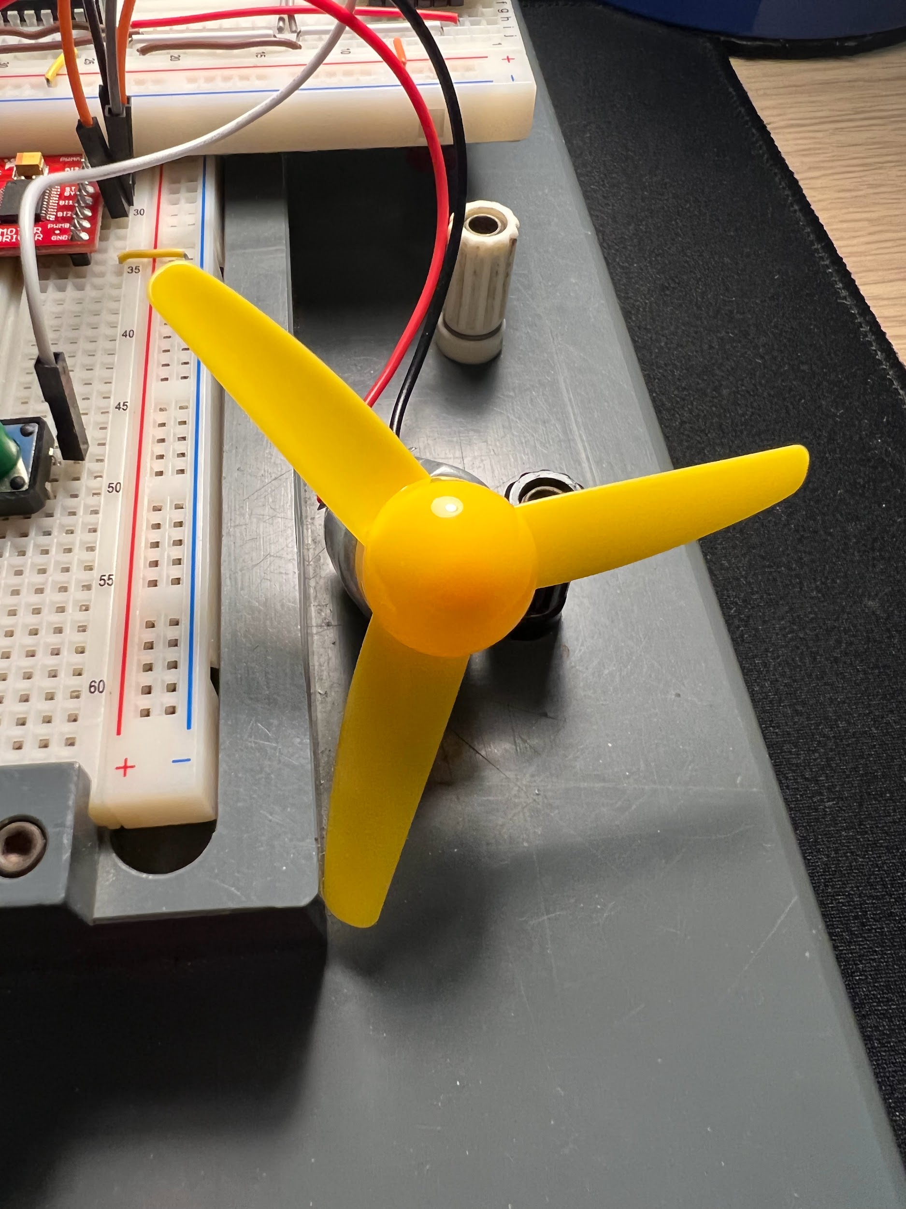
Motor Driver: TB6612FNG
PIC24 generates a PWM signal to control the speed of the motor
The motor driver uses 2 separate input signals to determine the motor function mode (CW, CCW, Short-Brake, Stop)
Includes Push Button and Fan
Notes:
Motor Control
Our project involves building a fan. We use a button to control different modes for the speed of the fan (fast, medium, slow), which changes the PWM signal parameter in PIC24 Microcontroller accordingly and controls the speed of the motor. We use a DC Motor Driver at different speeds to run the motor using different PWM..

Slide 7
Motor Driver: TB6612FNG (Main Component)
Pin Label | Function | Power/Input/Output | Notes
VM | Motor Voltage | Power | The power for the motors: 2.2V to 13.5V
VCC | Logic Voltage | Power | The Voltage to power the chip and talk to the microcontroller: 2.7V to 5.5V
GND | Ground | Power | Common Ground for both motor voltage and logic voltage
STBY | Standby | Input | Allows the H-bridges to work when high
AIN1/BIN1 AIN2/BIN2 | Input 1/2 for channel A/B | Input | Inputs that determines the motor controller function mode.
PWMA/PWMB | PWM input for channel A/B | Input | PWM input that controls the speed
A01/B01 A02/B02 | Output 1/2 for channel A/B | Output | Outputs to connect the motor

Slide 8
Motor Driver: TB6612FNG
In1 | In2 | PWM | Out1 | Out2 | Mode
H | H | H/L | L | L | Short brake
L | H | H | L | H | CCW
L | H | L | L | L | Short brake
H | L | H | H | L | CW
H | L | L | L | L | Short brake
L | L | H | OFF | OFF | Stop
Speed Controls (PWM)
Note: STBY must be high for the motors to drive

Slide 9
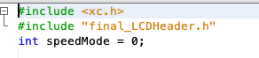
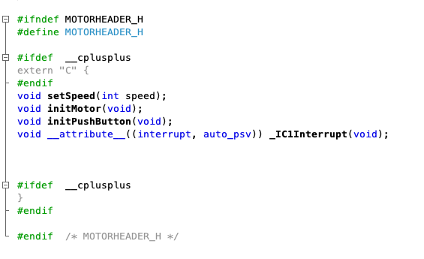
Libraries For Motor Driver
motorHeader.h
MotorLib.c
void setSpeed(int speed);
void initMotor(void);
void initPushButton(void);
void_IC1Interrupt(void);

Slide 10
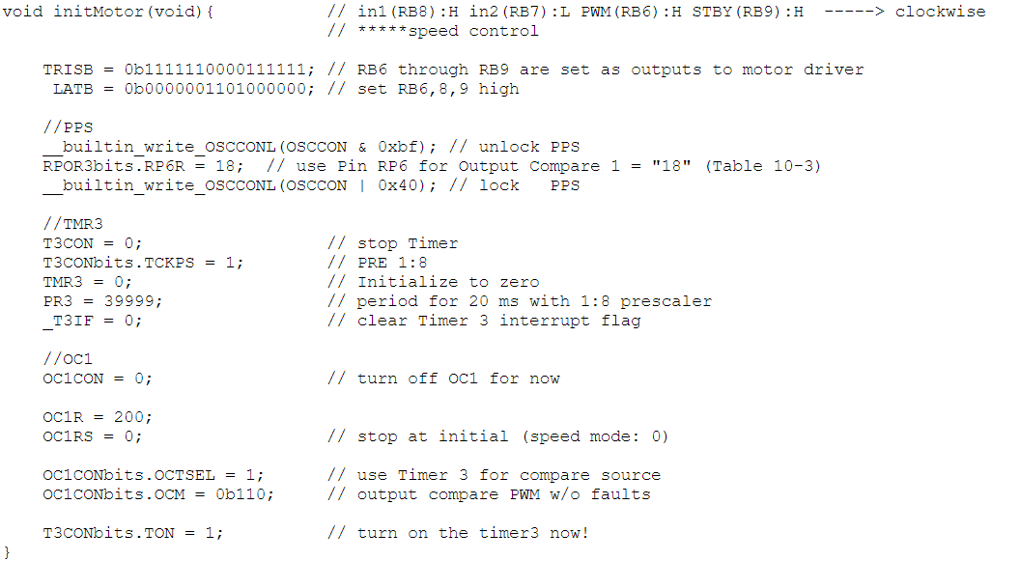
Libraries For Motor Driver (1/3)
void initMotor(void);
Initialization of the TB6612FNG Motor Driver. Vary the PWM by changing the value of OC1RS to control the motor speed
Notes:
Initialization of the motor within this code, sets the AIN pins at the beginning in order to set the motor driver in the correct mode which is clockwise for us
Unlock pps and set OC1 to rb6 to output compare
Use timer 3 for output compare and set up OC1 as a PWM signal to control the motor driver

Slide 11
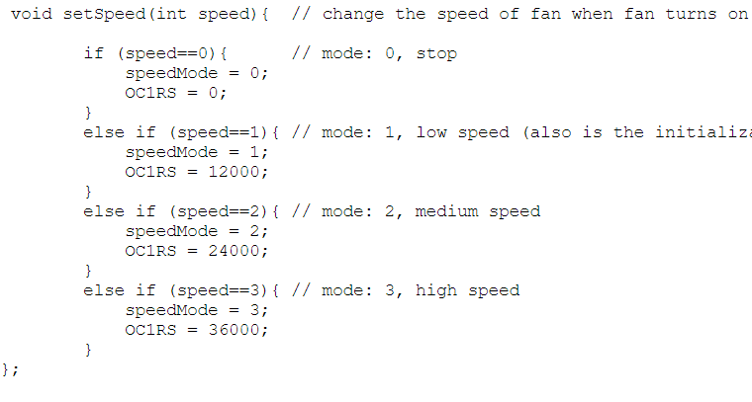
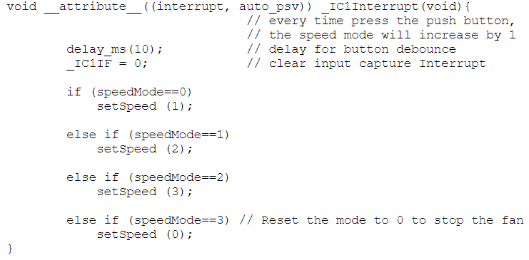
Libraries For Motor Driver (2/3)
void setSpeed(int speed);
Changes value of speedMode and motor speed modes by changing OC1RS of PWM in Output Compare
void_IC1Interrupt(void);
Input Capture Interrupt to detect button press. Changes motor speed modes by calling void setSpeed(int speed)
Notes:
Setspeed will change OC1RS in order to change the width of the PWM signal which then will adjust the speed
The IC1 interrupt which is bound to the button will end up calling the setspeed function to adjust the speed of the motor; it will have 4 settings at speed = 0 it will be off, at speed = 1 for low, speed = 2 for medium, and speed = 3 for high. The button will cycle through these modes by adding 1 to speed mode until it will hit 4 then it will be set back to 0 to repeat the cycle.

Slide 12
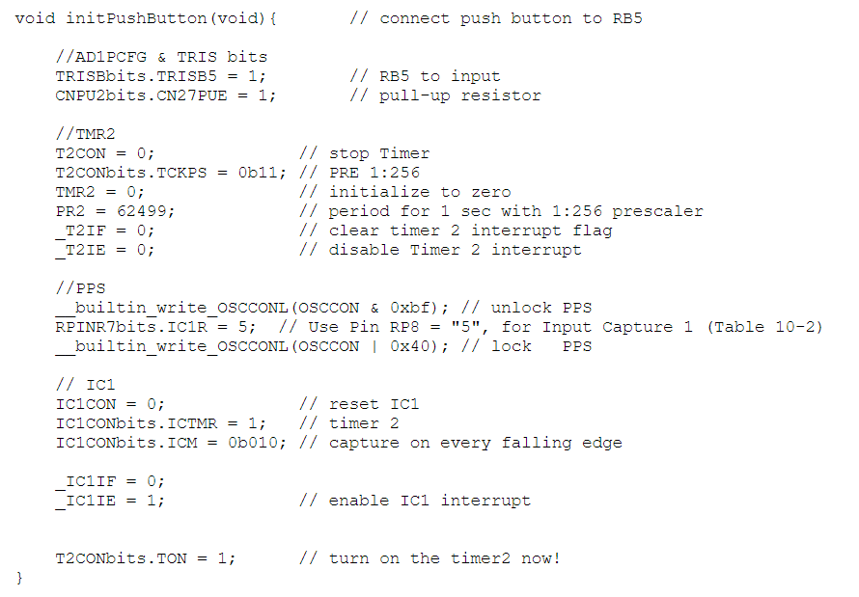
Libraries For Motor Driver (3/3)
void initPushButton(void);
Initializes button to detect falling edge by pressing
Uses Input Capture to detect every falling edge
Timer 2 was set for Input Capture comparison
Notes:
This code will initialize timer 2 and bind input compare 1 to timer 2. RP8/RB8 will be used for this and a button will be used to toggle this interrupt with it capturing every falling edge.

Slide 13
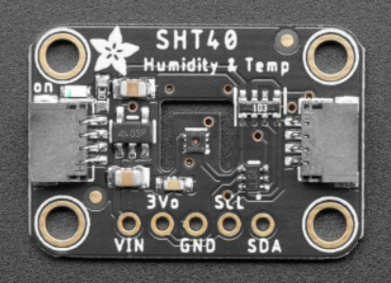
Humidity & Temp Sensor: SHT40
The temperature is read by an SHT40 sensor
I2C protocol was used to interface with the temperature sensor
The library provides functionality for initializing and reading bytes of data from the sensor
Notes:
Reading and Displacement of the temperature
Additionally, we plan to implement a temperature sensor that turns the fan on automatically when the temperature is above a certain range. When the temperature reaches the working temperature, the corresponding value given by the sensor will be recorded and set as the value to turn on the motor. We display the temperature and the mode of the fan speed in an LCD Display by PIC 24

Slide 14
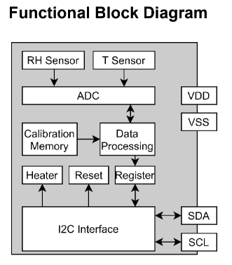
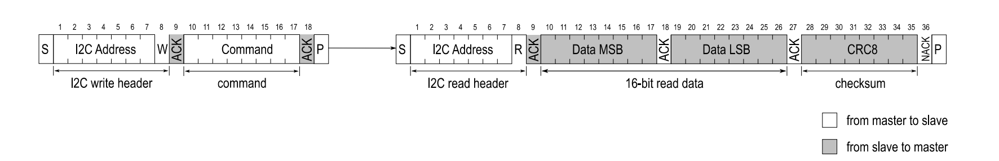
Humidity & Temp Sensor: SHT40 (Main Component)
VDD : 3.3 V
VSS : Ground
SDA : clock line for I2C
SCL : data line for I2C
Humidity and temperature data will always be transmitted in the following way: The first value is the temperature signal (2 * 8-bit data + 8-bit CRC), the second is the humidity signal (2 * 8-bit data + 8-bit CRC).

Slide 15
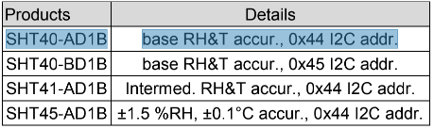
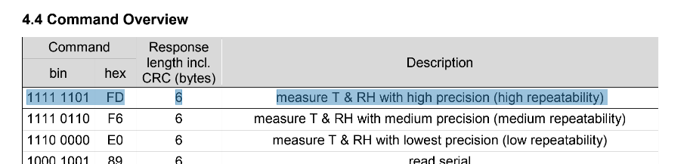
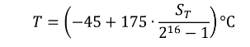
Humidity & Temp Sensor: SHT40 (Main Component)
I2C Slave Address: 0x44
Command: 0xFD
Measure T & RH with high precision (high repeatability)
Conversion of Signal Output:

Slide 16
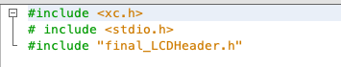
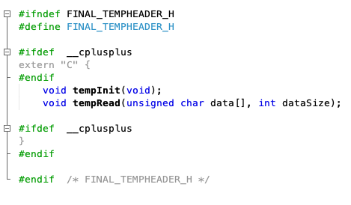
Libraries For Humidity & Temp Sensor
final_TempHeader.h
TempLib.c
void tempInit(void);
void tempRead(unsigned char data[], int dataSize);

Slide 17
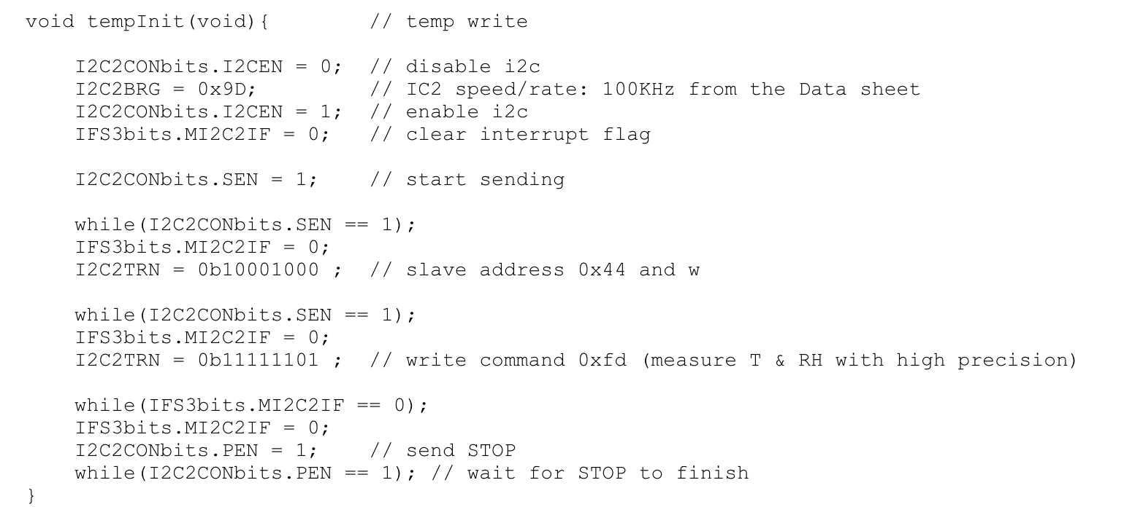
Libraries For Humidity & Temp Sensor (1/2)
void tempInit(void);
Write temp data in sensor by high precision
Initialization of the Temperature Sensor SHT40
Send data to Slave
Sets I2C rate to 100KHz

Slide 18
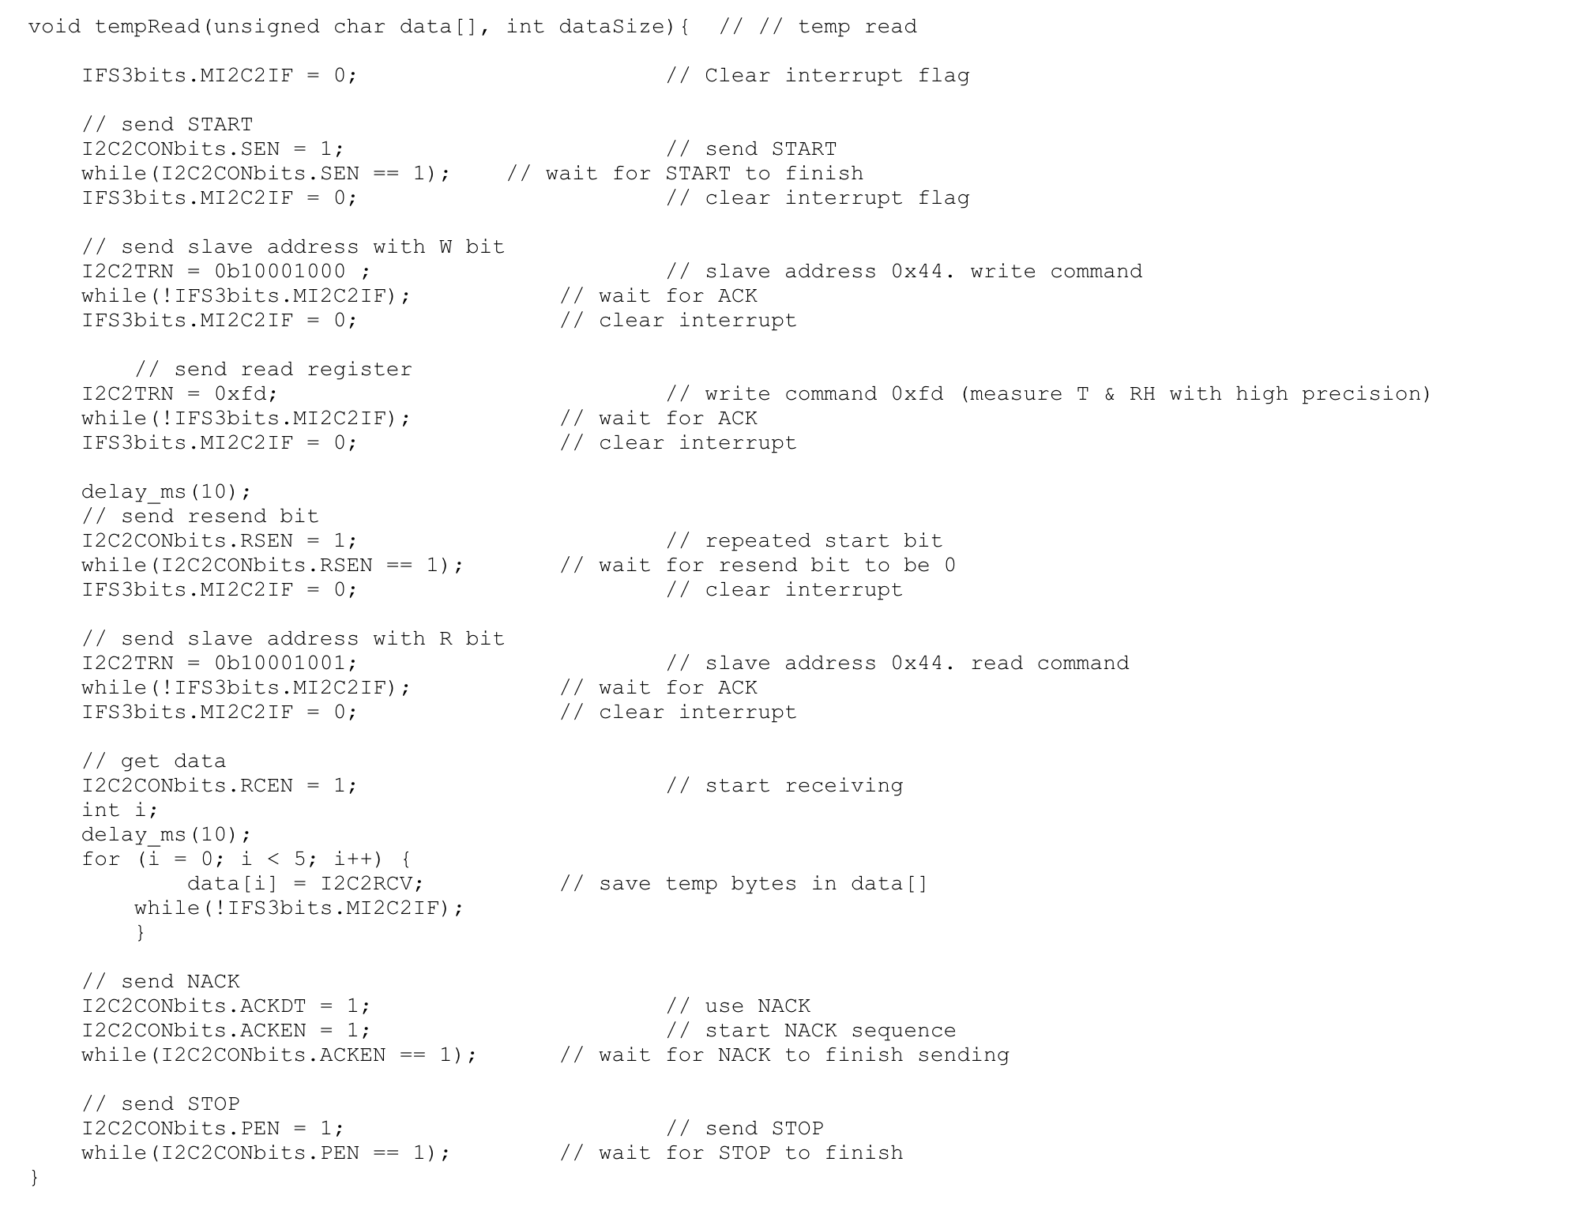
Libraries For Humidity & Temp Sensor (2/2)
void tempRead(unsigned char data[], int dataSize);
Read temp data from sensor to data[]
Receive data from Slave

Slide 19
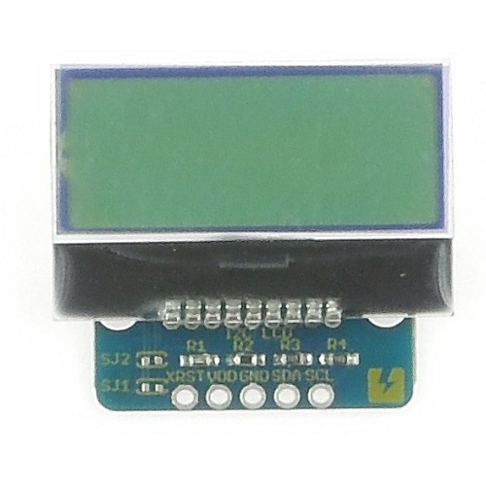
LCD Display: AQM0802A-RN-GBW
LCD Display shows the temperature data read from the sensor
Uses I2C interfacing to communicate with the PIC24
Notes:
data structures and algorithms for temperature display

Slide 20
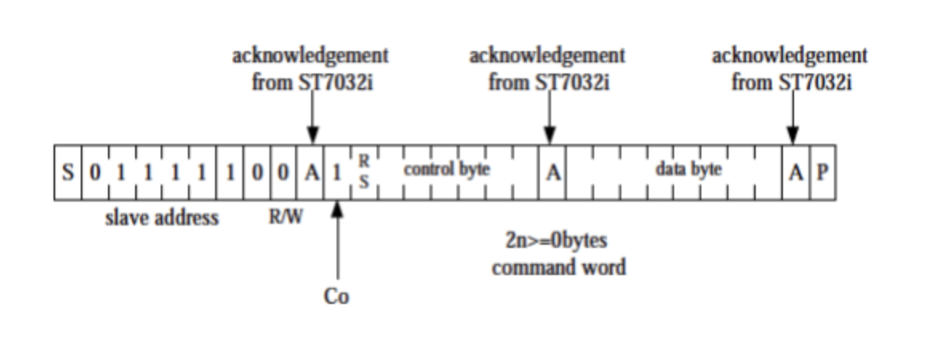
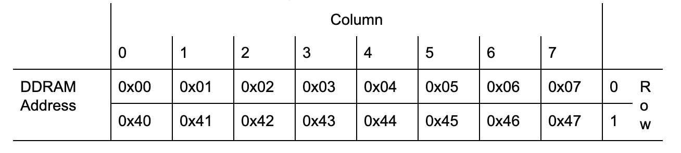
LCD Display: AQM0802A-RN-GBW (Main Component)
I2C Slave Address: 0b111110
Display Memory Location Pointer

Slide 21
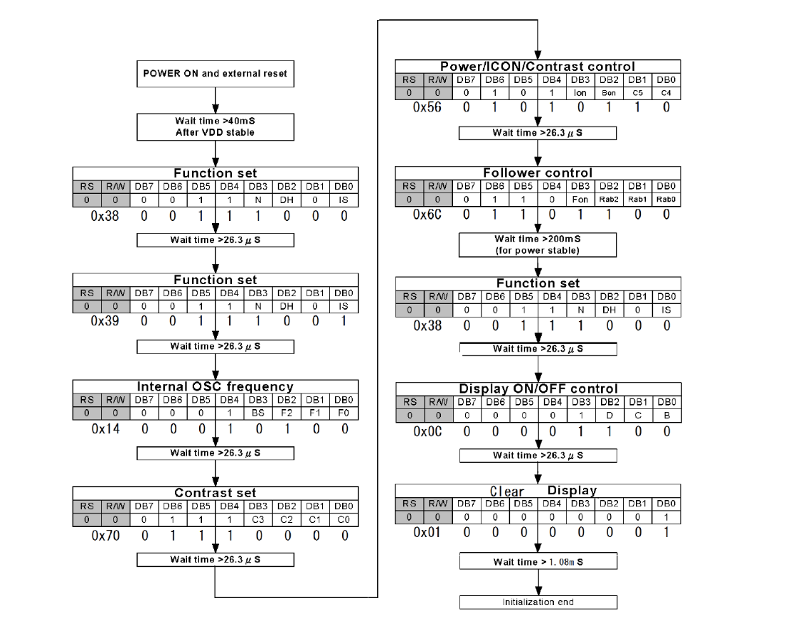
LCD Display: AQM0802A-RN-GBW (Main Component)
LCD Initialization
The LCD module needs several commands to be issued via the I2C bus in order to initialize correctly.

Slide 22
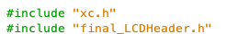
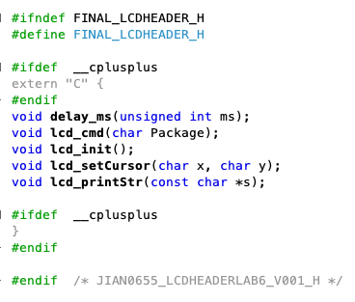
Libraries For LCD Display: AQM0802A-RN-GBW
final_LCDHeader.h
final_LCDLib.c
void delay_ms(unsigned int ms);
void lcd_cmd(char Package);
void lcd_init(void);
void lcd_setCursor(char x, char y);
void lcd_printStr(const char *s);

Slide 23
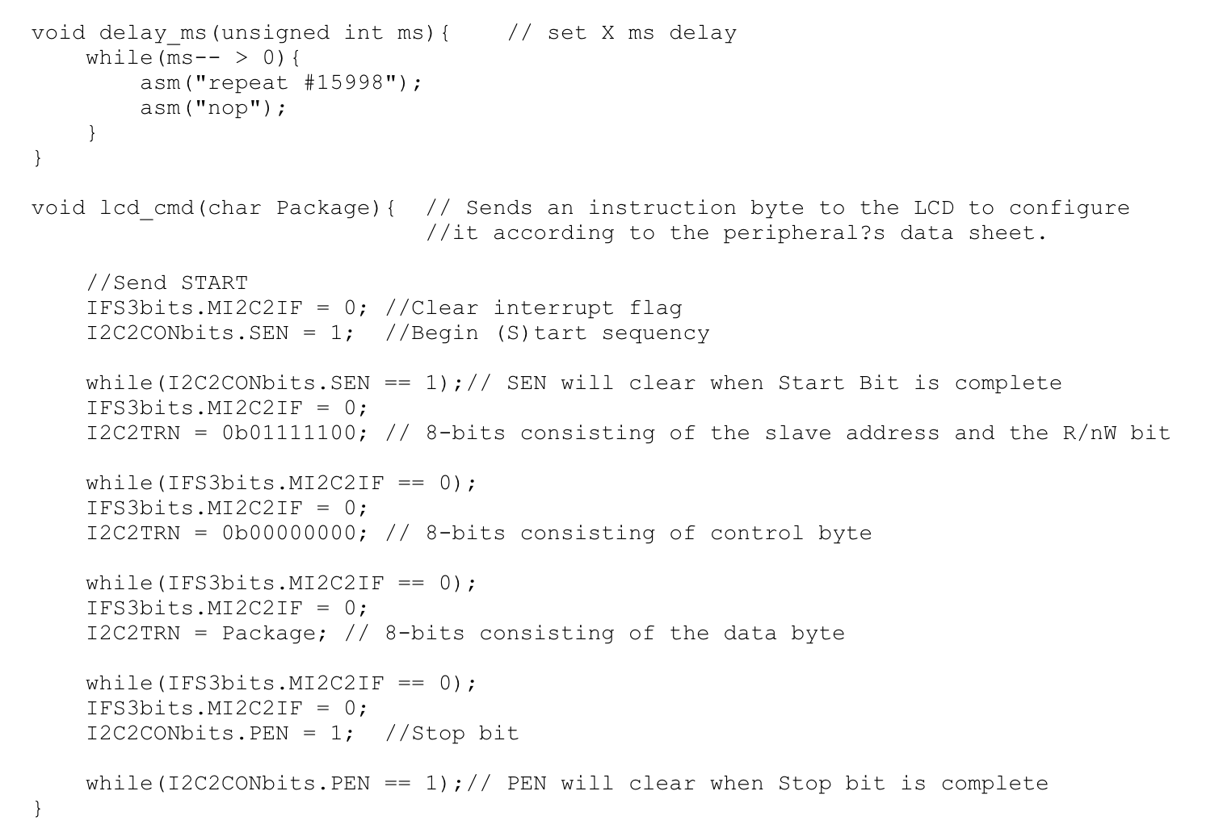
Libraries for LCD Display: AQM0802A-RN-GBW (1/3)
void delay_ms(unsigned int ms);
Used for delay in ms
void lcd_cmd(char Package);
Sends an instruction byte to the LCD to configure it according to the peripherals data sheet

Slide 24
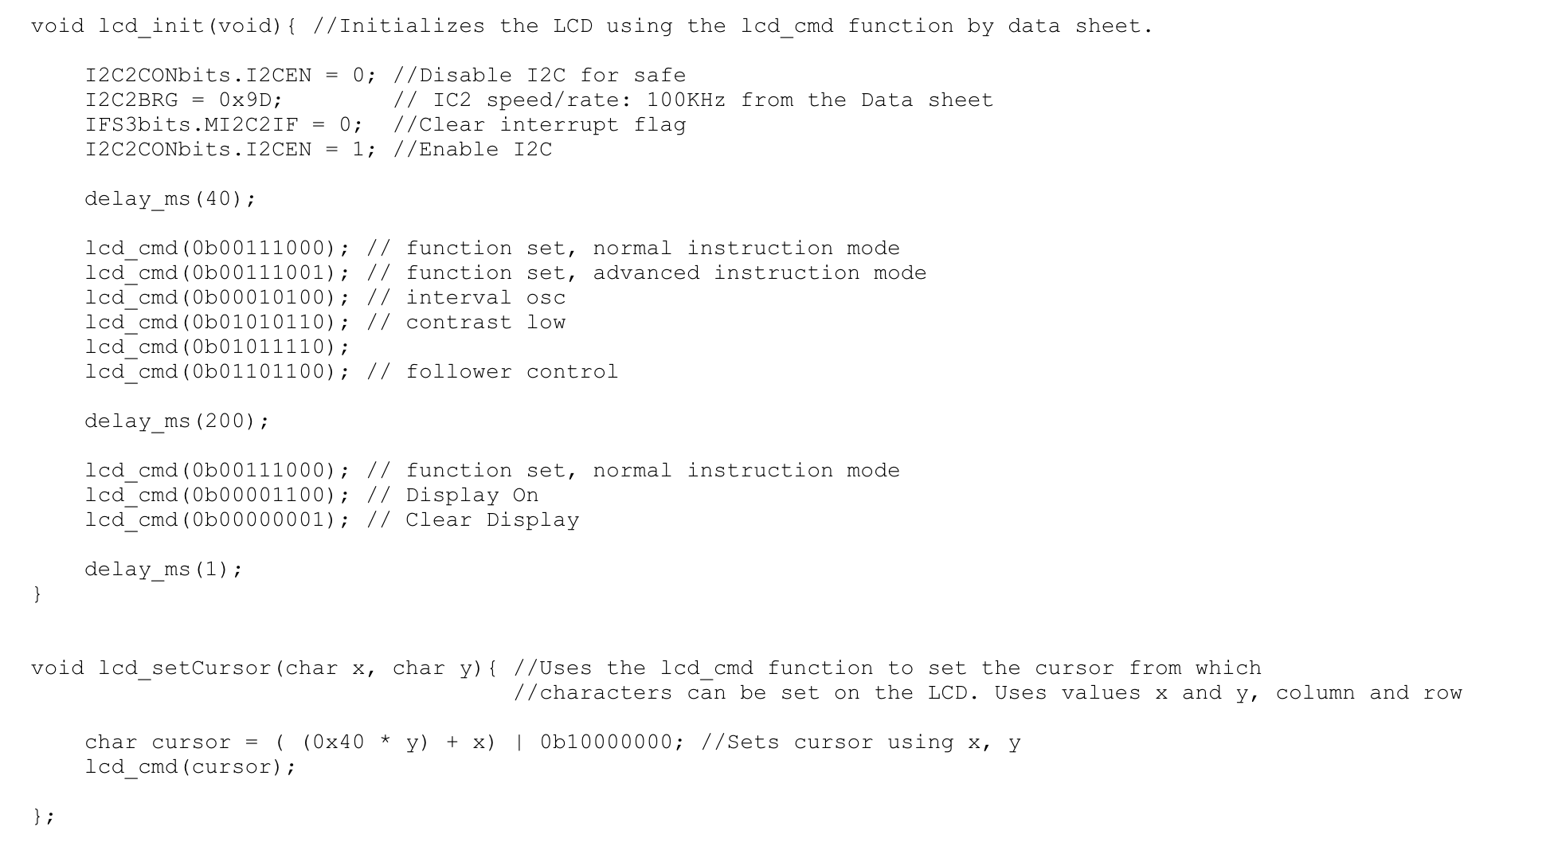
Libraries For LCD Display: AQM0802A-RN-GBW (2/3)
void lcd_init(void);
Initializes the LCD by calling void lcd_cmd(char Package) giving different values for the data byte
void lcd_setCursor(char x, char y);
Calls void lcd_cmd(char Package) to set the cursor from which characters can be set on the LCD
Uses values x and y : column and row

Slide 25
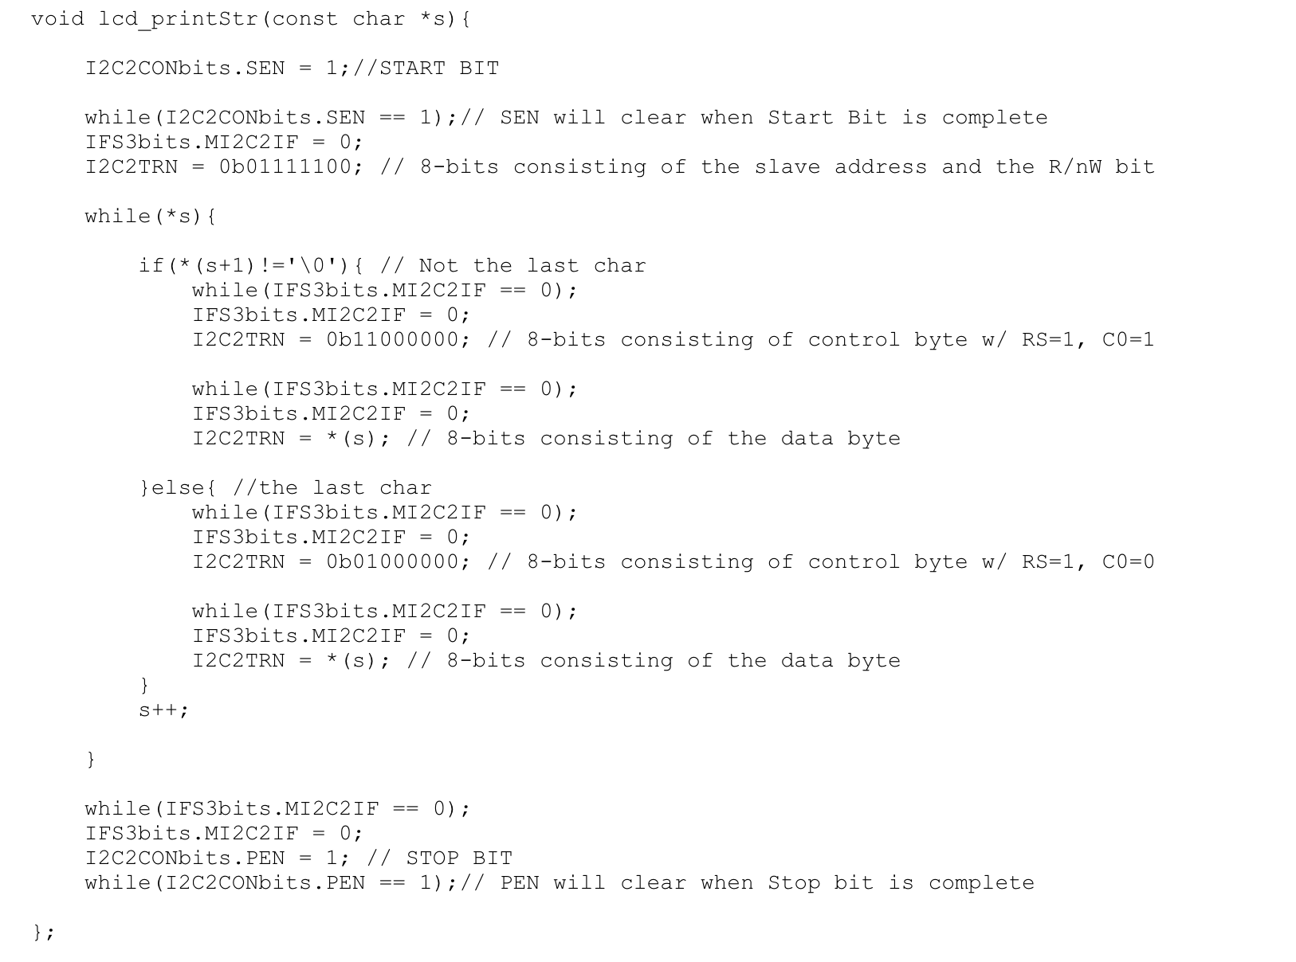
Libraries for LCD Display: AQM0802A-RN-GBW (3/3)
void lcd_printStr(const char *s);
Prints a series of characters on the LCD based on the position of the cursor

Slide 26
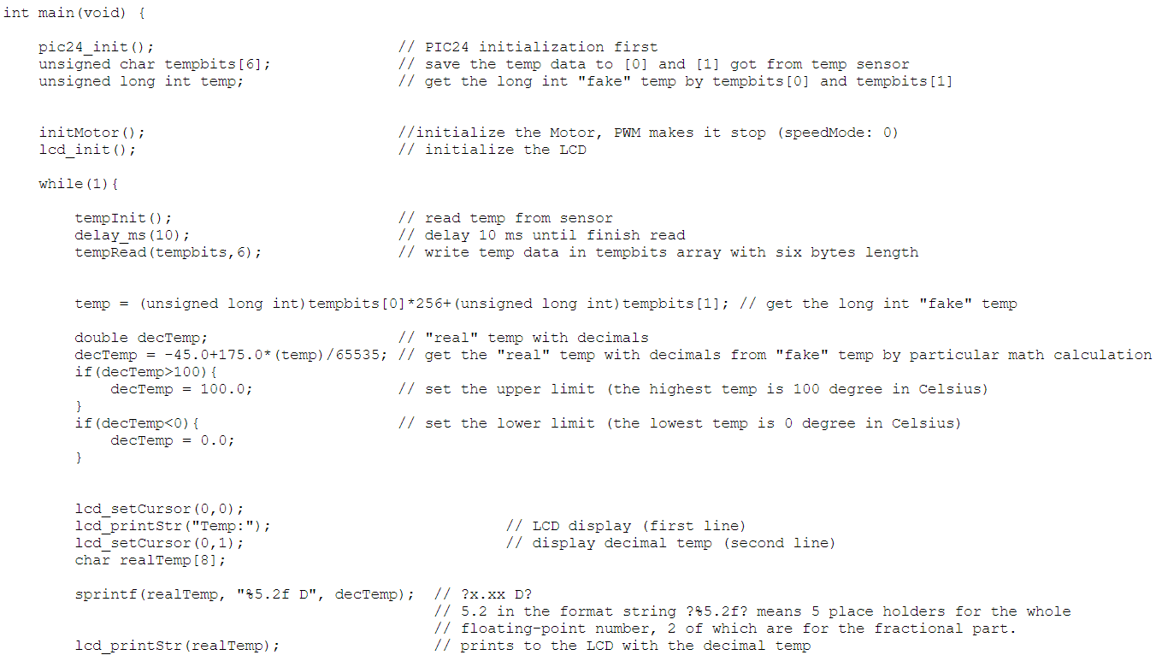
Main Function
void pic24_init(void);
Sets 16MHz frequency for PIC24
Sets all pins to digital
int main(void)
The initialization part is performed first:
void pic24_init(void);
void initMotor(void);
void lcd_init(void);
void tempInit(void);
Writes and reads temp and displays it on the LCD:
void delay_ms(unsigned int ms);
void tempRead(unsigned char data[], int dataSize);
void lcd_setCursor(char x, char y);
void lcd_printStr(const char *s);

Slide 27
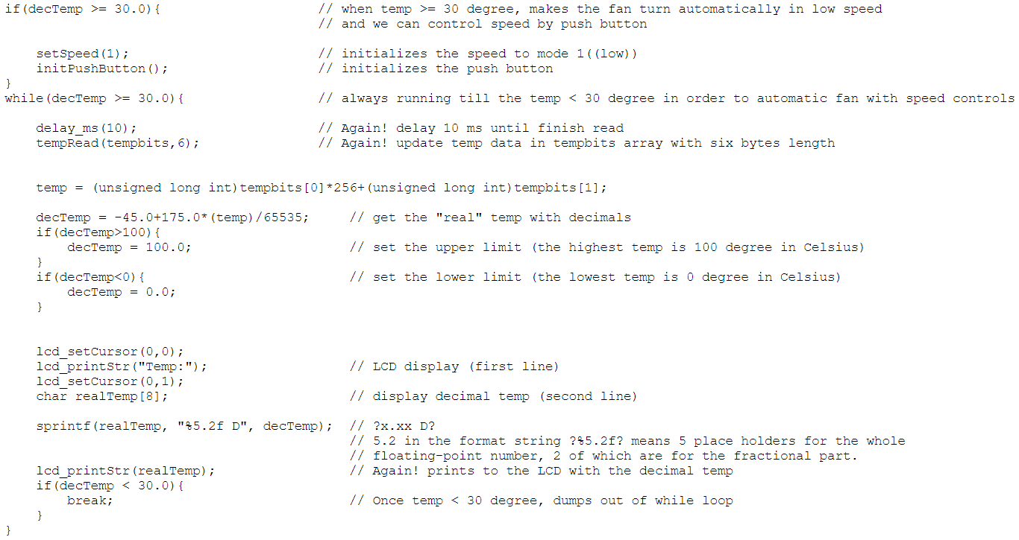
Main Function
int main(void)
If the temperature is greater than or equal to 30 degrees, continue to update the temperature, set the speedmode to 1 and initialize the Push Button so that pressing it will change the speed:
void setSpeed(int speed); (only runs one time)
void initPushButton(void);
void_IC1Interrupt(void);
Until the temperature drops below 30 degrees again, jump out of the loop of greater than or equal to 30 degrees and stop the motor, and finally continue to update the temperature:
void setSpeed(int speed);

Slide 28
Shortfalls
The press of the button is not stable enough (speed modes change unexpectedly sometimes)
An error in reading the second temperature byte (LSB), which causes the temperature to change less smoothly on the LCD
The sensor is slow to dissipate heat causing the temperature to rise quickly and fall slowly

Slide 29
Conclusion
Project contains clearly defined libraries and new devices
3 libraries
MotorLib.c / TempLib.c / final_LCDLib.c
3 peripherals
Motor Driver / Humidity & Temp Sensor / LCD Display
Learned
I2C: one Master supports multiple Slave devices
I2C: send and receive data
Input Capture for detecting falling edge
Output Compare for PWM
Understand how the motor driver (plus the motor) works
Understand how the Humidity & Temp Sensor works
Future
The temperature-controlled fan can be used to automatically cool people in a hot environment, circulate air, or cool down electric devices. It has good practical significance and usefulness.
Basic understanding of I2C, sensors, LCD, etc., which provides a solid foundation for more complex digital circuit design in the future.
Understood the importance of collaboration within a team setting which helped clarify goals in future digital circuit design.

Slide 30
Contributions
Yuan Jiang | jian0655@umn.edu | Main Programmer Main Code Debugger Main PPT Producer Main PPT Touch-up Main Hardware Connecter Demo Presenter
Soorya Sundravel | sundr030@umn.edu | Main Demo Presenter Main Code Debugger I2C Programmer PPT Touch-up Hardware Connecter
Hongyu Wang | wang9529@umn.edu | Main Demo Presenter Main PPT Producer Main PPT Touch-up Main Code Debugger
Thomas Skrzek | skrze005@umn.edu | Main Demo Presenter Motor Programmer PPT Touch-up

